Slide 1
Calories Burned
Prediction
Domain:
Machine Learning

Slide 2
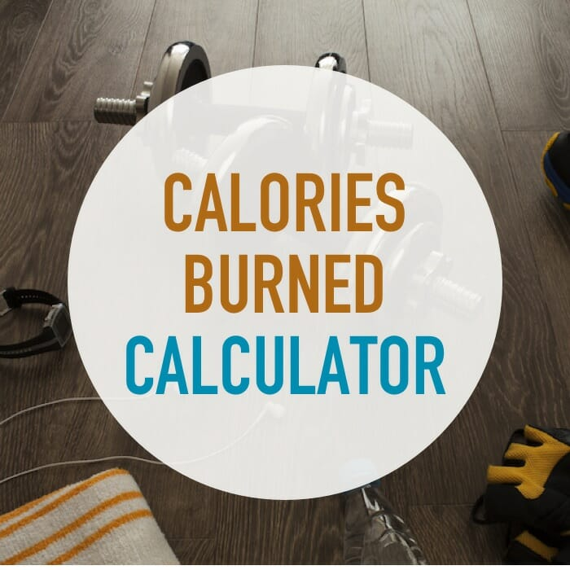
Introduction:
In today's fast-paced world, individuals increasingly rely on wearable fitness trackers and mobile applications to monitor their physical activity and track the number of calories burned. Regular exercise and diet tracking have become essential aspects of many people's daily routines. People are very interested in understanding the balance between the calories they consume through their diet and the calories they burn through various physical activities and exercises. For example, they want to know how many calories they intake when they eat specific foods and how many calories they burn during different exercises. This information helps them maintain a healthy lifestyle and achieve their fitness goals.

Slide 3

Technologies Used:
Python
Flask
Pandas
pickle-mixin
scikit-learn
Xgboost
werkzeug

Slide 4

PROCESS:
In this project, we will be using the XGBoost Regressor to train our machine learning algorithm. Here is the workflow that we will follow:
Data Collection:
Gather the necessary data for training our machine learning model. This data should include features like age, height, weight, duration of exercise, heart rate, body temperature, and gender.
Data Preprocessing:
Clean and preprocess the data to ensure it's in the right format for training. This may include handling missing values, encoding categorical variables (like gender), and normalizing or scaling the features.
Model Training:
Train the XGBoost Regressor using the preprocessed training data. The XGBoost Regressor is chosen because this is a regression problem where we aim to predict the number of calories burned based on the input features.
Model Evaluation:
Evaluate the performance of the trained XGBoost Regressor using a test dataset. This will help us understand how well our model generalizes to new, unseen data.
Model Deployment:
Once the model is trained and evaluated, we can save it using pickle and deploy it in our Flask application to make predictions based on user inputs.

Slide 5
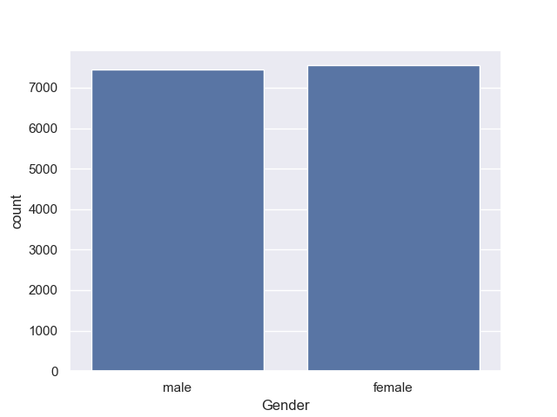
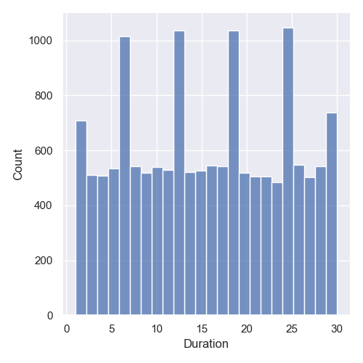
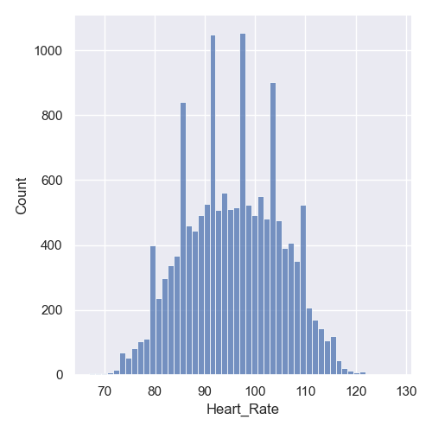
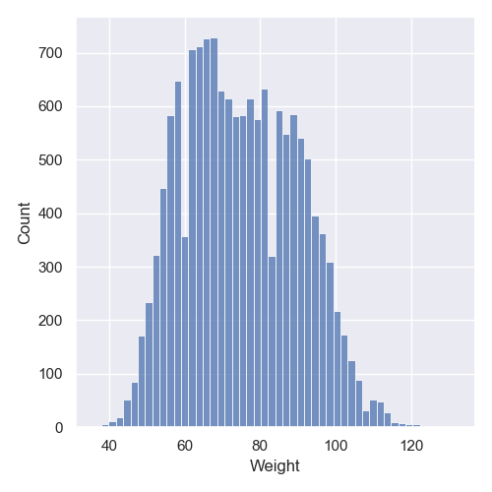
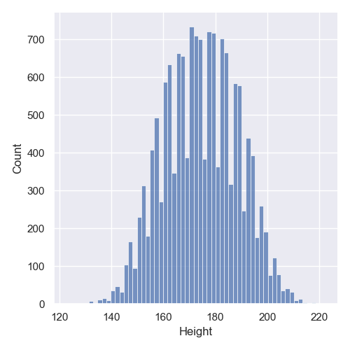
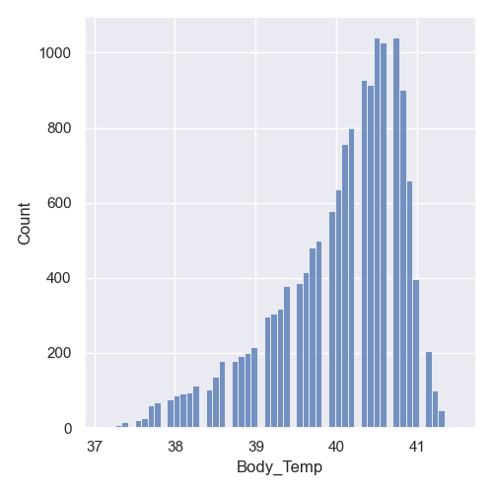
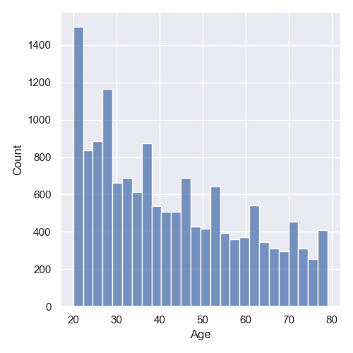
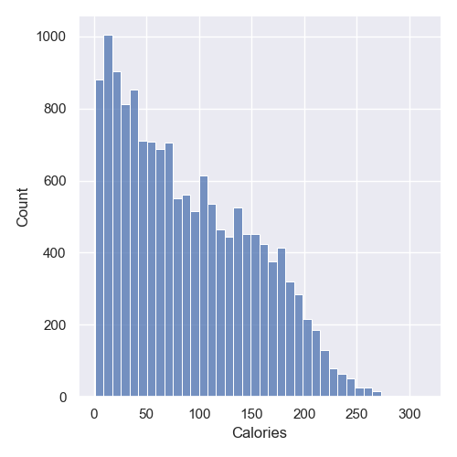
.
.
Statistical Measures of Data Sets
In Graphical Representation.

Slide 6
Overview and Insights
1.Data and Model:
Dataset: 15,000 records
Model: XGBoost Regressor
Performance: Mean Absolute Error (MAE) of nearly 1
2.Data Visualization:
Distribution: Used a count plot to show the distribution of males and females in the dataset.
3.Workflow:
Data Collection and Preprocessing: Cleaned and prepared the dataset.
Model Training and Evaluation: Trained XGBoost Regressor and evaluated its performance.
Web Application: Built using Flask to allow user interaction and predictions.

Slide 7
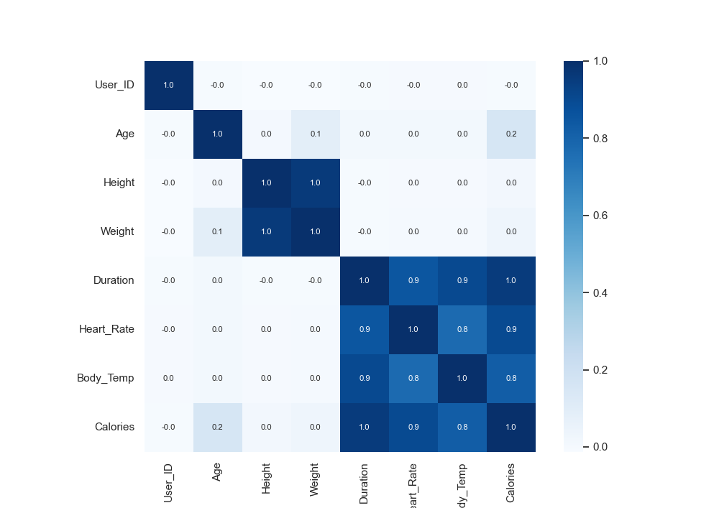
Statistical Measures of Dataset Metrics

Slide 8
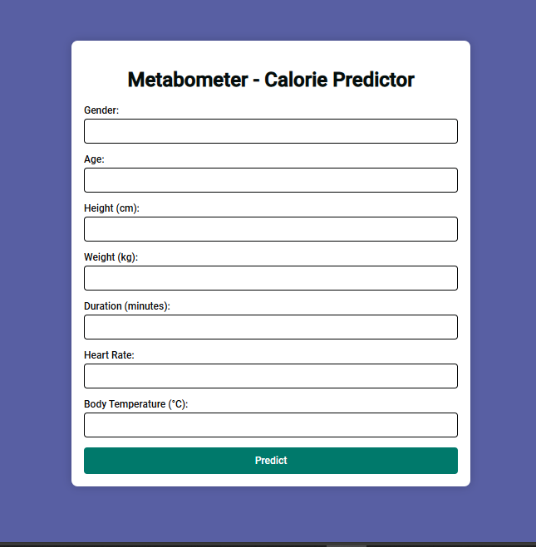
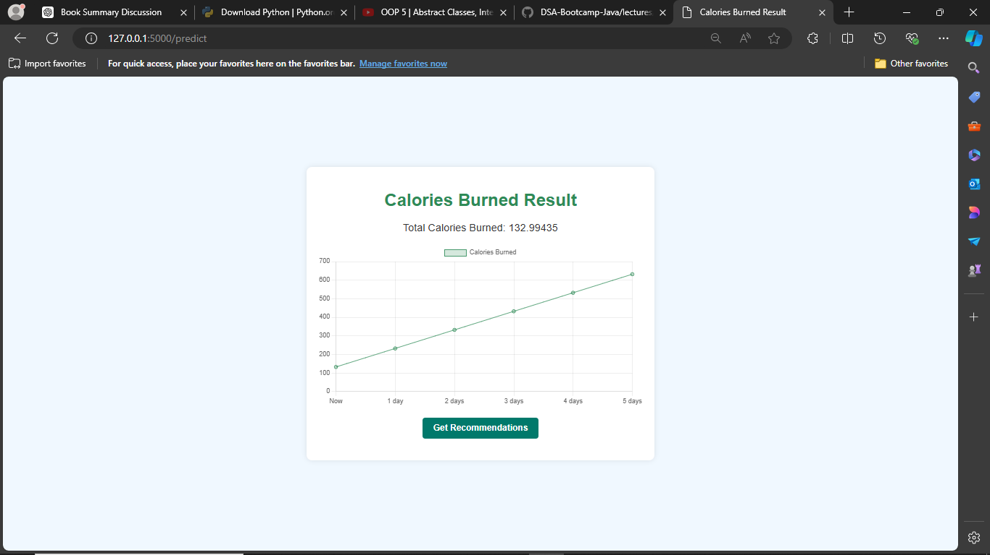
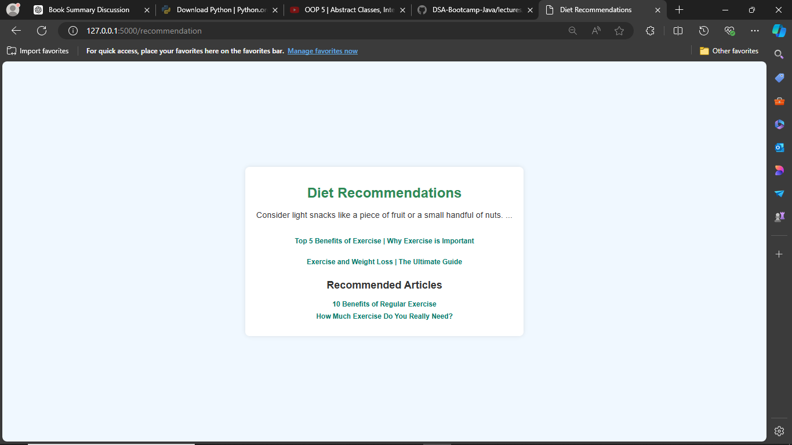
Project Overview

Slide 9
Conclusion:
This project successfully created a web application for predicting calories burned based on user inputs such as age, height, weight, exercise duration, heart rate, body temperature, and gender. Using Python's Flask framework and XGBoost for the machine learning model, we ensured accurate and reliable predictions. The application offers a user-friendly interface where users can easily input their data and receive instant calorie predictions. This tool can help users monitor their fitness and make informed decisions about their diet and exercise routines. Future improvements could include personalized recommendations and continuous model updates for enhanced accuracy.

Slide 10
THANK YOU
G Karthik - 245521733144
Garlapati Sai Vinny Reddy - 245521733147
Vaddemoni Hari Priya -245521733191

